Slide 1
UNIT 2 INTRODUCTION TO DJANGO FRAMEWORK

Slide 2
Understanding Django environment
Django is a high-level Python web framework that enables rapid development of secure and maintainable websites.
Django takes care of the difficult stuff so that you can concentrate on building your web applications.
It is free and open source, has a thriving and active community, great documentation.
Django emphasizes reusability of components.
It is based on MVT (Model View Template) design pattern.

Slide 3
Django – Design Philosophies
Django comes with the following design philosophies −
Loosely Coupled − Django aims to make each element of its stack independent of the others.
Less Coding − Less code so in turn a quick development.
Don't Repeat Yourself (DRY) − Everything should be developed only in exactly one place instead of repeating it again and again.
Fast Development − Django's philosophy is to do all it can to facilitate hyper-fast development.
Clean Design − Django strictly maintains a clean design throughout its own code and makes it easy to follow best web-development practices.

Slide 4
Features of Django
Rapid Development: The project implementation phase is very time taking but Django creates it rapidly.
Secure: Django takes security seriously and helps developers to avoid many common security mistakes, such as SQL injection, cross-site scripting, cross-site request forgery etc.
Scalable: Django is scalable in nature and has ability to quickly and flexibly switch from small to large scale application project.
Fully loaded: Django includes various helping task modules and libraries which can be used to handle common Web development tasks.
Versatile: Django is versatile in nature which allows it to build applications for different-different domains. Using Django you can build various types of applications like: content management systems, social networks sites or scientific computing platforms etc.
Open Source: Django is an open source web application framework. It is publicly available without cost. Open source reduces the total cost of the application development.
Vast and Supported Community: Django is an one of the most popular web framework. It has widely supportive community and channels to share and connect.

Slide 5
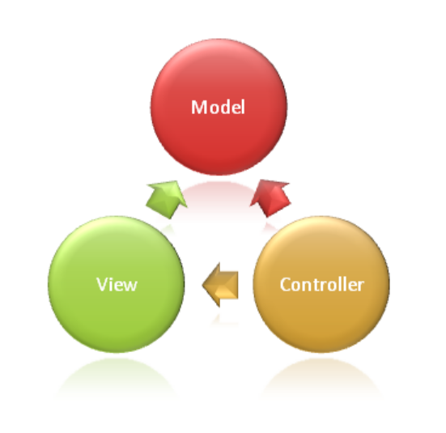
Django Architecture MVC model

Slide 6
Model: This handles your data representation, it serves as an interface to the data stored in the database itself, and also allows you to interact with your data without having to get perturbed with all the complexities of the underlying database.
View: As the name implies, it represents what you see while on your browser for a web application or In the UI for a desktop application.
Controller: provides the logic to either handle presentation flow in the view or update the model’s data i.e. it uses programmed logic to figure out what is pulled from the database through the model and passed to the view, also gets information from the user through the view and implements the given logic by either changing the view or updating the data via the model , To make it more simpler, see it as the engine room.

Slide 7
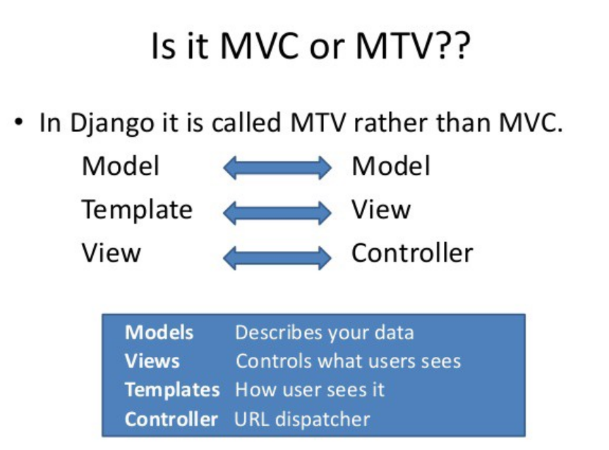

Slide 8
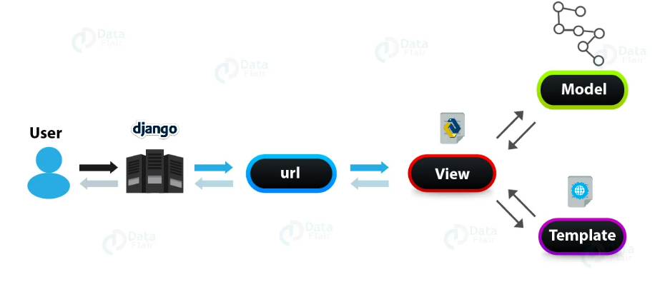
MTV Model

Slide 9
Model: Just like the Model explanation in the MVC pattern , this also takes the same position as the interface or relationship between the data and contains everything related to data access and validation.
Template: This relates to the View in the MVC pattern as it is the presentation layer that handles the presentation logic in the framework and basically controls what should be displayed and how it should be displayed to the user.
View: This part relates to the Controller in the MVC pattern and handles all the business logic that throws down back to the respective templates. It serves as the bridge between the model and the template

Slide 10
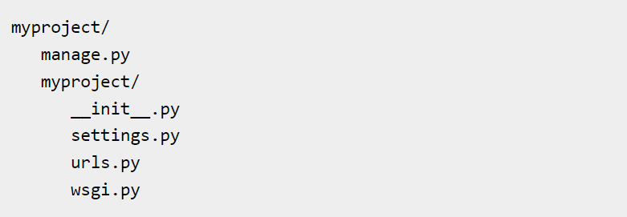
Create a Project
Open cmd prompt and navigate to the place you want your project to be created, then use this code −
This will create a "myproject" folder with the following structure:
django-admin startproject myproject

Slide 11
The Project Structure
The “myproject” folder is just your project container, it actually contains two elements −
manage.py − This file is kind of your project local django-admin for interacting with your project via command line (start the development server, sync db...).
The “myproject” subfolder − This folder is the actual python package of your project. It contains four files −
__init__.py − Just for python, treat this folder as package.
settings.py − As the name indicates, your project settings.
urls.py − All links of your project and the function to call.
wsgi.py − If you need to deploy your project over WSGI.

Slide 12
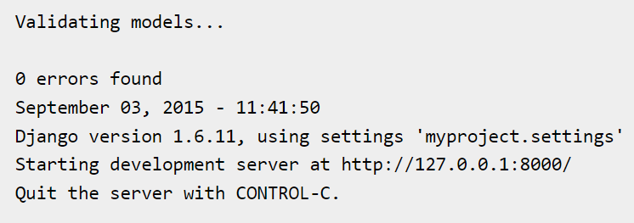
Run the Django Project
Now that your project is created and configured make sure it's working:
Which will produce this result:
python manage.py runserver

Slide 13
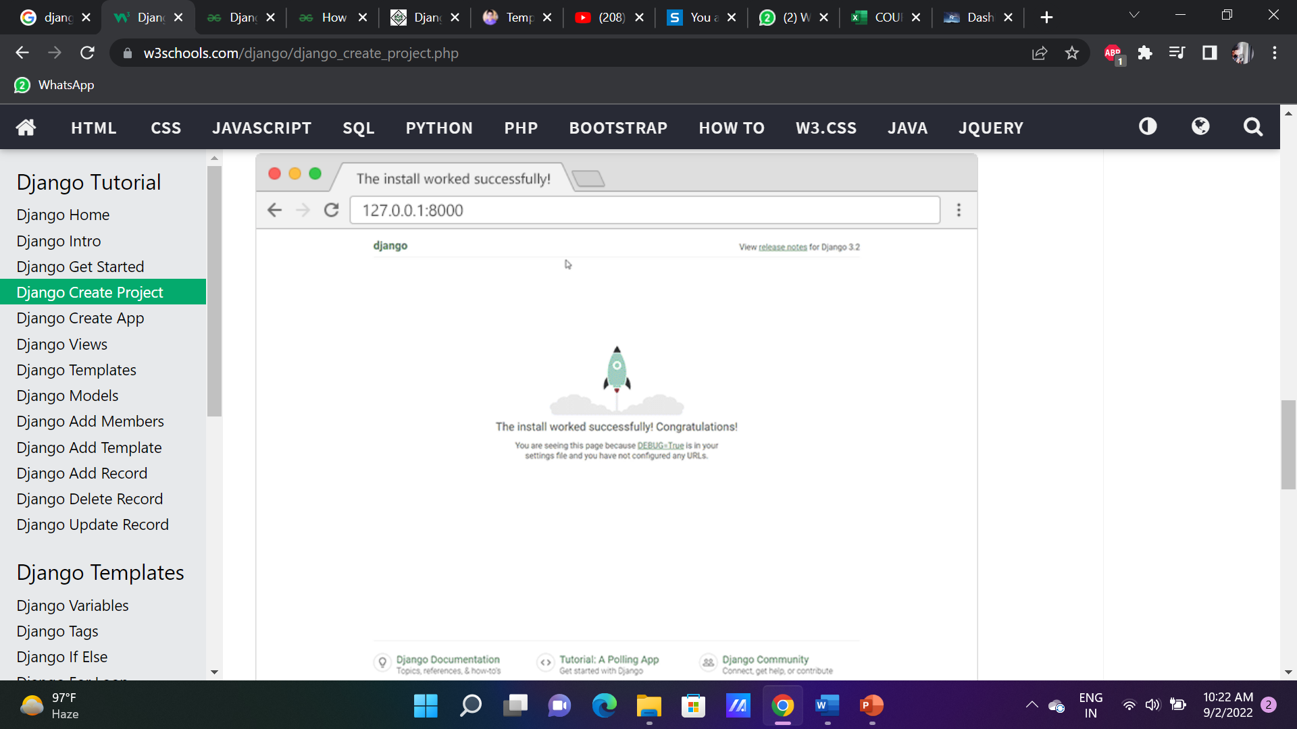
Open a new browser window and type 127.0.0.1:8000 in the address bar.
The result:

Slide 14
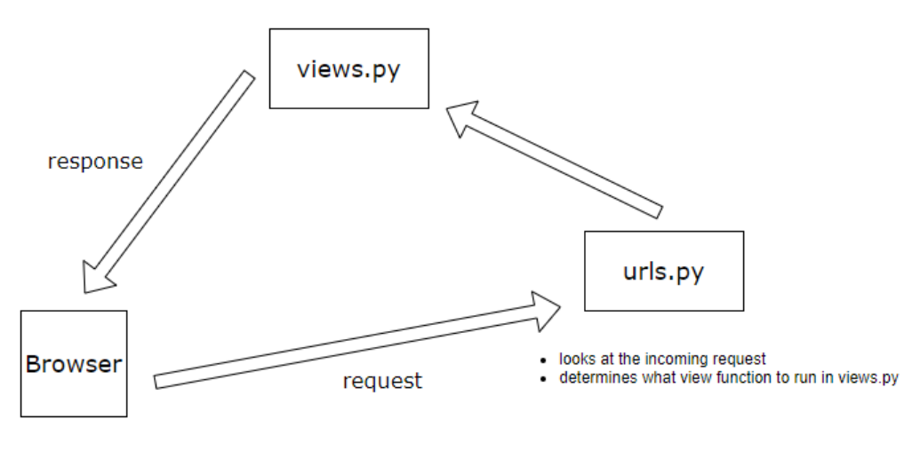
Django URLs and Views

Slide 15
When a web request is made to a Django application, it is the job of the urls.py file to determine what to do with that request. This is what is known as routing in a web application.
So you might have URLs set up in your project like and so on.
Each of those routes will trigger a different function in the views.py file.
Each different function will perform a different operation depending on the route the user has chosen via the web browser.
/contact, /stats, /about-us

Slide 16
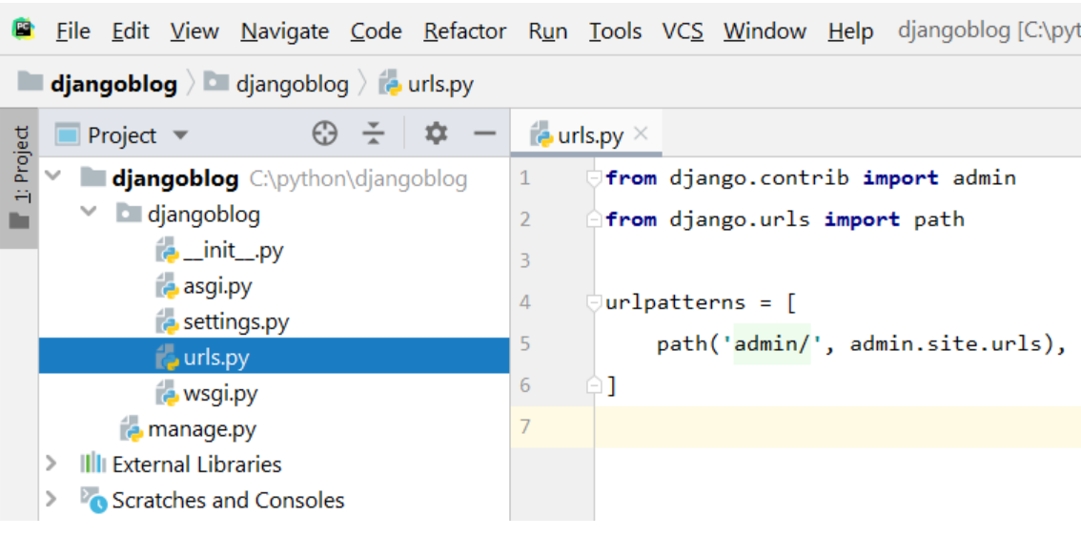
Adding A New Route
Open the urls.py file that is in the root app folder.
For example, we want to add a route for an about page.

Slide 17
djangoblog/urls.py
from django.contrib import admin
from django.urls import path
from . import views
urlpatterns = [
path('admin/', admin.site.urls),
path('about/', views.about)
]
What the code above is saying is that when someone visits the /about page in a web browser, the urls.py file will look in the views.py file and trigger the about(). We don’t yet have that code in place yet, so let’s create it now.

Slide 18
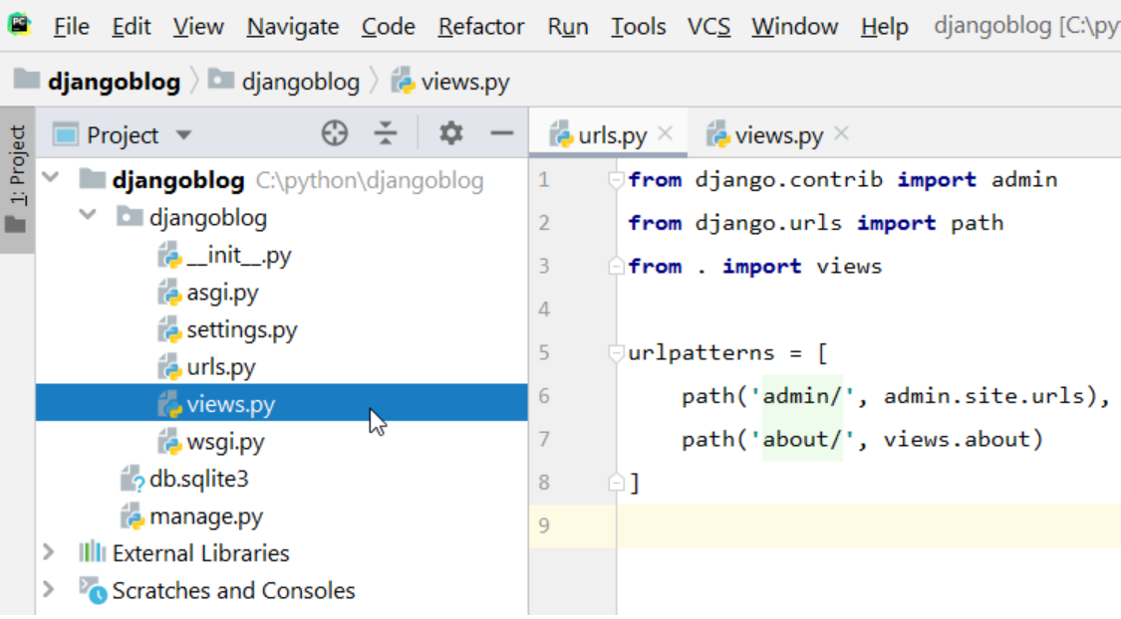
Once the new views.py file is created in the inner djangoblog folder, we can set up our function.
djangoblog/views.py
from django.http import HttpResponse
def about(request):
return HttpResponse('<h1>About!</h1>')
If we did everything correctly, we should be able to now start up the python local development server and test this out.

Slide 19
Django views are Python functions that takes http requests and returns http response, like HTML documents.
A web page that uses Django is full of views with different tasks and missions.
Views are usually put in a file called views.py located on your app's folder.

Slide 20
Django Templates
Django provides a convenient way to generate dynamic HTML pages by using its template system.
A template consists of static parts of the desired HTML output as well as some special syntax describing how dynamic content will be inserted.
In HTML file, we can't write python code because the code is only interpreted by python interpreter not the browser.
Django template engine is used to separate the design from the python code and allows us to build dynamic web pages.

Slide 21
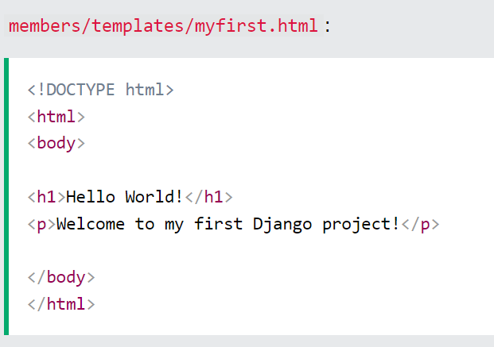
Creating a Template
Create a templates folder inside the members folder, and create a HTML file named myfirst.html.
Open the HTML file and insert the following:

Slide 22
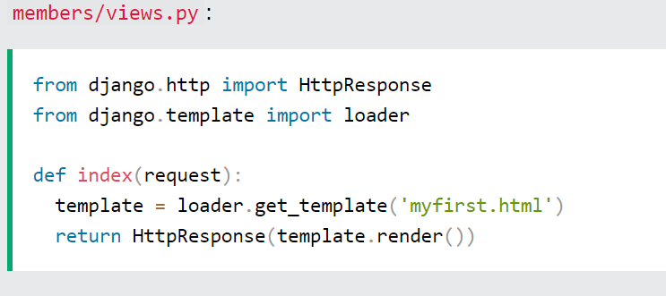
Modify the View
Open the views.py file and replace the index view with this:

Slide 23
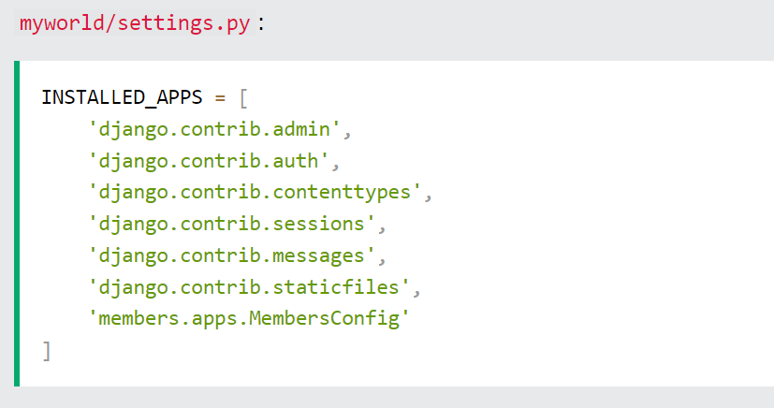
Change Settings
To be able to work with more complicated stuff than "Hello World!", We have to tell Django that a new app is created.
This is done in the settings.py file.
Look up the INSTALLED_APPS[], list and add the members app.

Slide 24
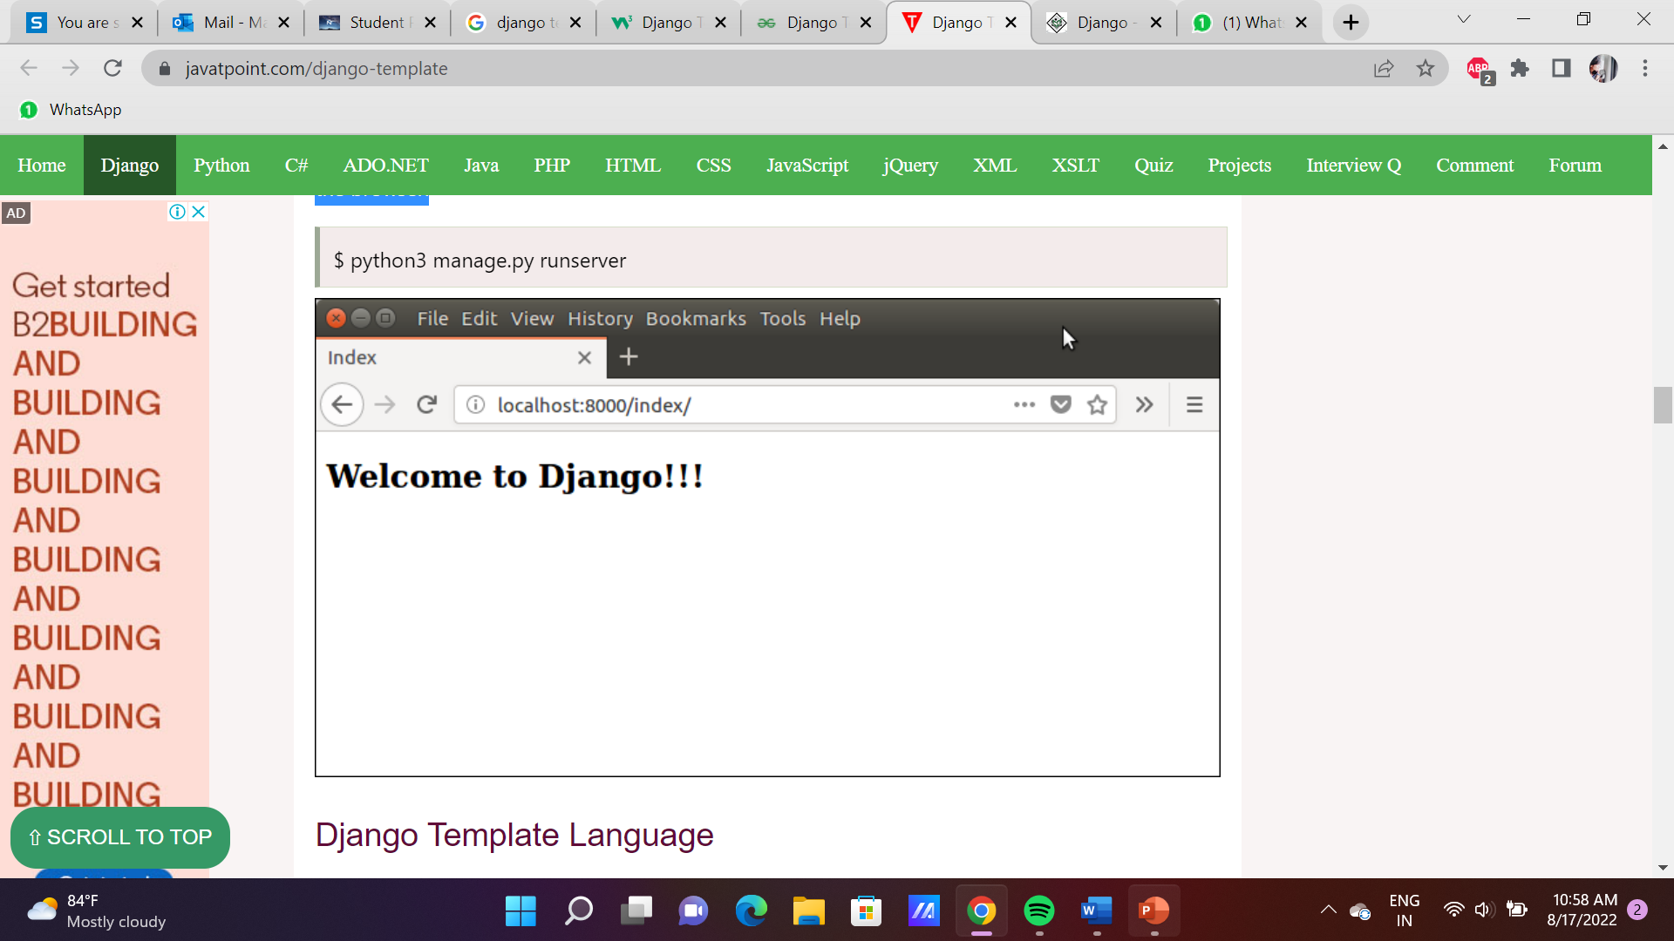
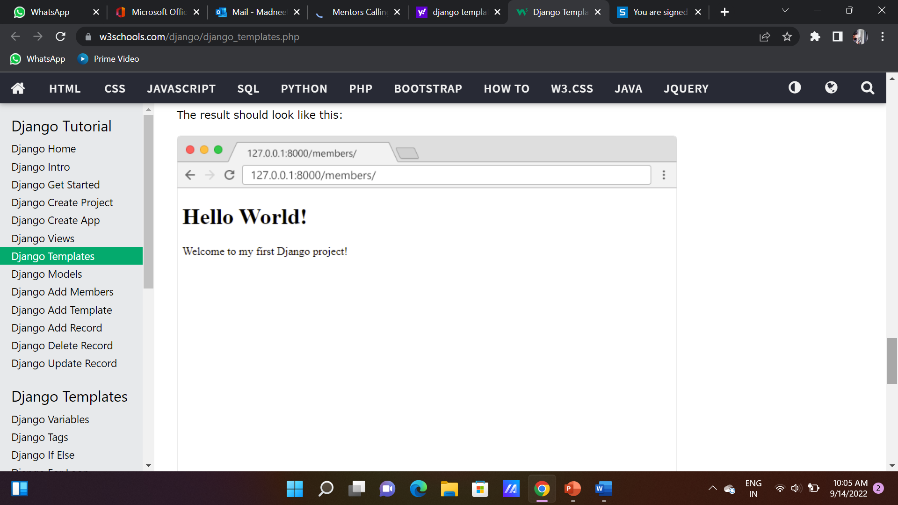
Run Server
Execute the following command and access the template by entering localhost:8000/index at the browser.

Slide 25
Django Template Inheritance
Template Inheritance is a method to add all the elements of an HTML file into another without copy-pasting the entire code. For example, consider the Facebook homepage.
The underlying theme of the web page; background, elements, etc., are same for all FB endpoints
There are two ways to achieve this:
Add the same CSS/JS/HTML code all the Endpoint Templates
Or, create a single file containing all common elements and then simply include it in others.
The second method is what exactly the Template Inheritance does.

Slide 26
Why Inheritance?
Just like Facebook, most of the Applications have long HTML codes for a single page itself. Now to write all that again and again for every page is not possible and a very inefficient method.
Thus Django provides the method of Template inheritance to ensure more efficiency and less repetition of code.
Another significant benefit with Template inheritance is that, if we modify the main file, it will automatically get changed at all places where it was inherited. Thus we don’t need to modify it at all other places.

Slide 27
Creating a base HTML file at the project level and then have the Django App templates inherit it.
Modify TEMPLATES in settings.py
To make the base file accessible, add the following line into TEMPLATES in settings.py as shown in screenshot below.
This line executes the following function:
We get the path of the Django project directory using the predefined variable BASE_DIR (Our Django project folder)
Then with the os module, we join it to the django_project/templates file.
'DIRS': [os.path.join(BASE_DIR,'django_project/templates')],

Slide 28
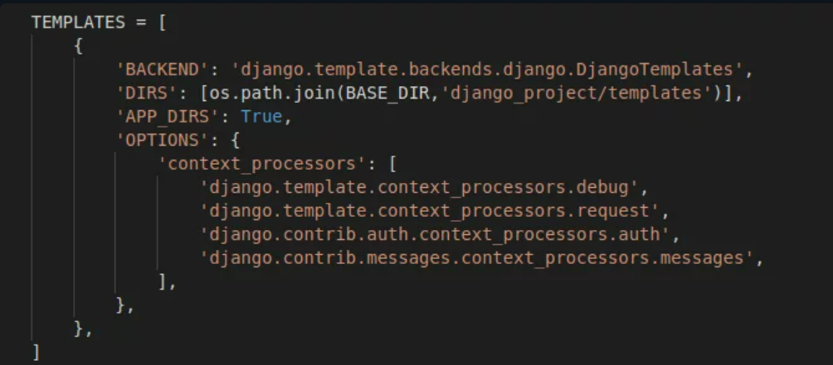
We are basically telling Django to search for templates outside the app, at the project level(path indicated by the above code) as well.

Slide 29
2) Coding the Parent Base HTML file
Create a template BaseTemplate.html in the Templates folder present at the Django project directory level outside all the Apps.
And add the following code into the file:
The base file should contain the {% block <block_name %} element.
When the base .html template will be inherited, the block content will be replaced by the other template’s contents.
<h2>Basic File Inheritence</h2> {% block <block_name> %} <p> PlaceHolder to be Replaced</p> {% endblock %}

Slide 30
3) Coding the App’s HTML Template files
Let us now code the App Template – “AppTemplate.HTML”, which will inherit the Base file. Add the code below into your template file in the Django App:
We need to add the template content in a similar Block with the same names as the parent file. The content of the blocks in the base file will be replaced with the corresponding block contents of this file.
Note: The {% extends ‘base.html’ %} line should always be present at the top of the file.
{% extends 'base.html' %} {% block content %} <h3>Welcome to the App</h3><br> {% endblock %}

Slide 31
4) Creating an App View to display the Template
We now just need a View to render and display our App Template. The Code for the View will be simply:
The URL path for the view:
from django.shortcuts import render def TemplateView(request): return render(request,'<app_name>/AppTemplate.html(path to the Template)')
path('template/', TemplateView)

Slide 32
Django Models
A model is the single, definitive source of information about your data. It contains the essential fields and behaviors of the data you’re storing. Generally, each model maps to a single database table.
A Django model is the built-in feature that Django uses to create tables, their fields, and various constraints. In short, Django Models is the SQL of Database one uses with Django.
Django models simplify the tasks and organize tables into models. Generally, each model maps to a single database table.

Slide 33
Basics of a model
Basics of a model include –
Each model is a Python class that subclasses django.db.models.Model.
Each attribute of the model represents a database field.
With all of this, Django gives you an automatically-generated database-access API.

Slide 34
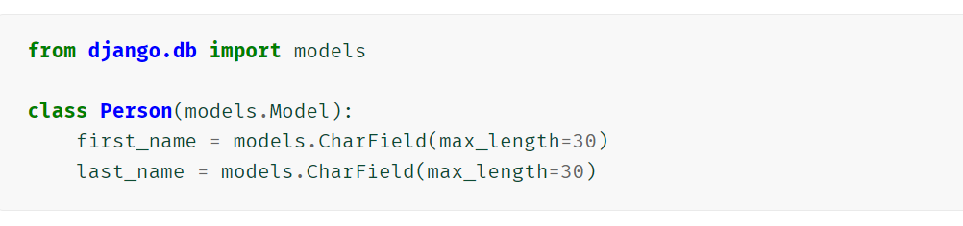
Example
This example model defines a Person, which has a first_name and last_name:
first_name and last_name are fields of the model. Each field is specified as a class attribute, and each attribute maps to a database column.

Slide 35

The above Person model would create a database table like this:
Some technical notes:
The name of the table, myapp_person, is automatically derived from some model metadata but can be overridden.
An id field is added automatically, but this behavior can be overridden.
The CREATE TABLE SQL in this example is formatted using PostgreSQL syntax, but it’s worth noting Django uses SQL tailored to the database backend specified in your settings file.

Slide 36
Creating a model
Syntax
from django.db import models
class ModelName(models.Model):
field_name =models.Field(**options)

Slide 37
Fields
The most important part of a model – and the only required part of a model – is the list of database fields it defines. Fields are specified by class attributes. Be careful not to choose field names that conflict with the models API like clean, save, or delete.
Fields are used to represent table columns and there are many different types of fields available in Django.
These different types of fields are used to decide which type of data a column should hold, for example- integer, string, date, etc. Setting up a field is just like deciding the data type of a column in the table.
Each field in a model is an instance of a Field class, and Django uses these field types to decide the column type, validation requirement, and many more things.

Slide 38
Field types
Each field in your model should be an instance of the appropriate Field class. Django uses the field class types to determine a few things:
The column type, which tells the database what kind of data to store (e.g. INTEGER, VARCHAR, TEXT).
The default HTML widget to use when rendering a form field (e.g. <input type="text">, <select>).
The minimal validation requirements, used in Django’s admin and in automatically-generated forms.

Slide 39
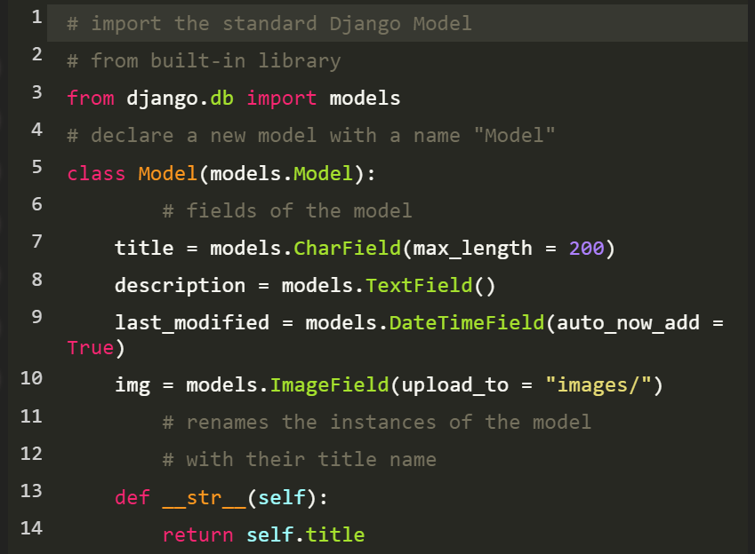

Slide 40
Whenever we create a Model, Delete a Model, or update anything in any of models.py of our project, we need to run two commands:
makemigrations and migrate.
makemigrations basically generates the SQL commands for preinstalled apps (which can be viewed in installed apps in settings.py) and your newly created app’s model which you add in installed apps whereas migrate executes those SQL commands in the database file.

Slide 41
When we run,
SQL Query to create above Model as a Table is created and
creates the table in the database.
Python manage.py makemigrations
Python manage.py migrate

Slide 42
Integrating Bootstrap into Django
Bootstrap is a framework which is used to create user interface in web applications. It provides css, js and other tools that help to create required interface.
In Django, we can use bootstrap to create more user friendly applications.
To implement bootstrap, we need to follow the following steps.

Slide 43
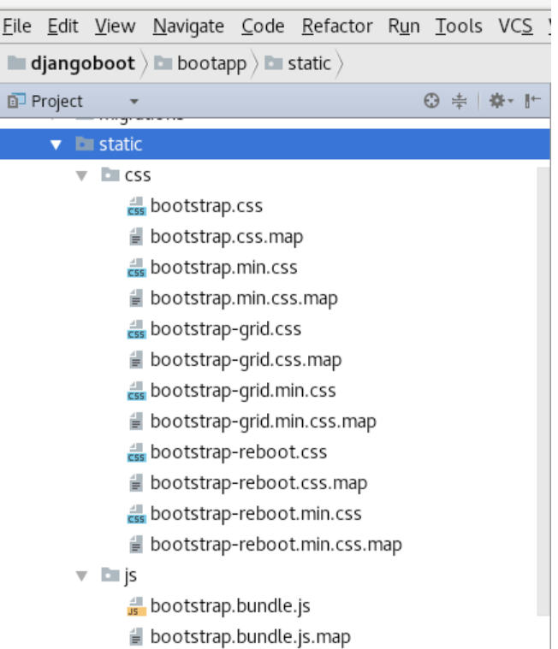
Download the Bootstrap
2. Create a Directory
Create a directory with the name static inside the created app and place the css and js folders inside it.

Slide 44
3. Create a Template
First create a templates folder inside the app then create a index.htm file to implement (link) the bootstrap css and js files.
4. Load the Boostrap
load the bootstrap files resides into the static folder. Use the following code.
{% load staticfiles %}
And link the files by providing the file location (source). See the index.html file.

Slide 45
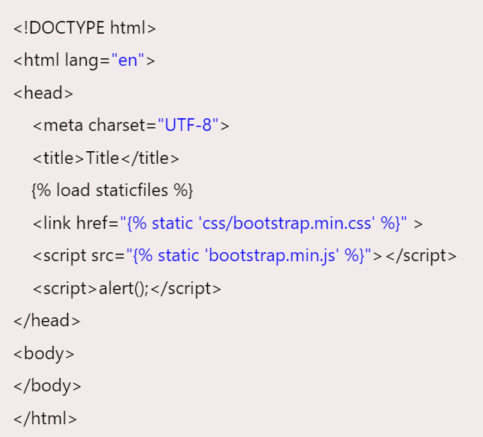
In this template, we have link two files one is bootstrap.min.css and second is bootstrap.min.js.

Slide 46
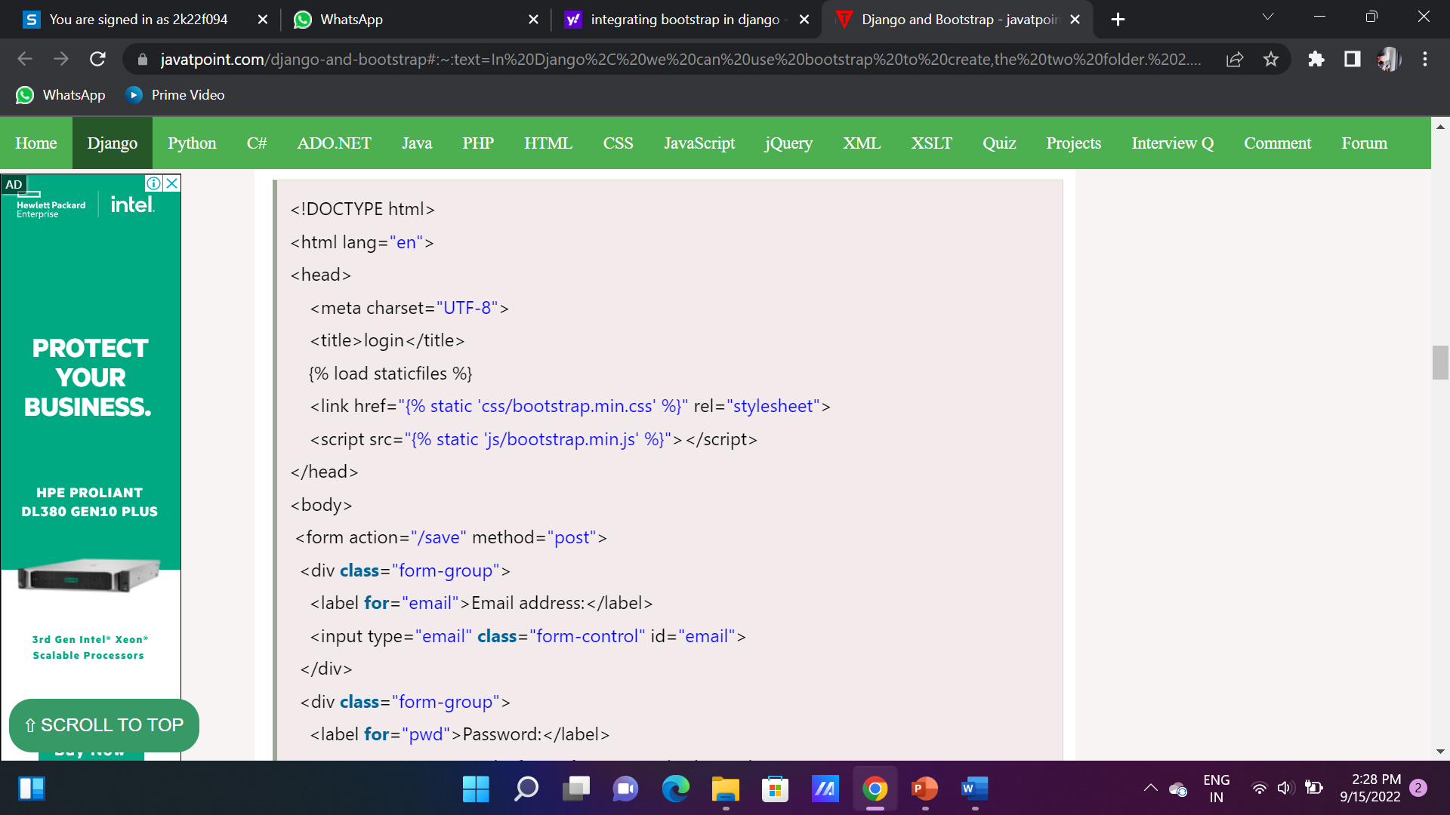
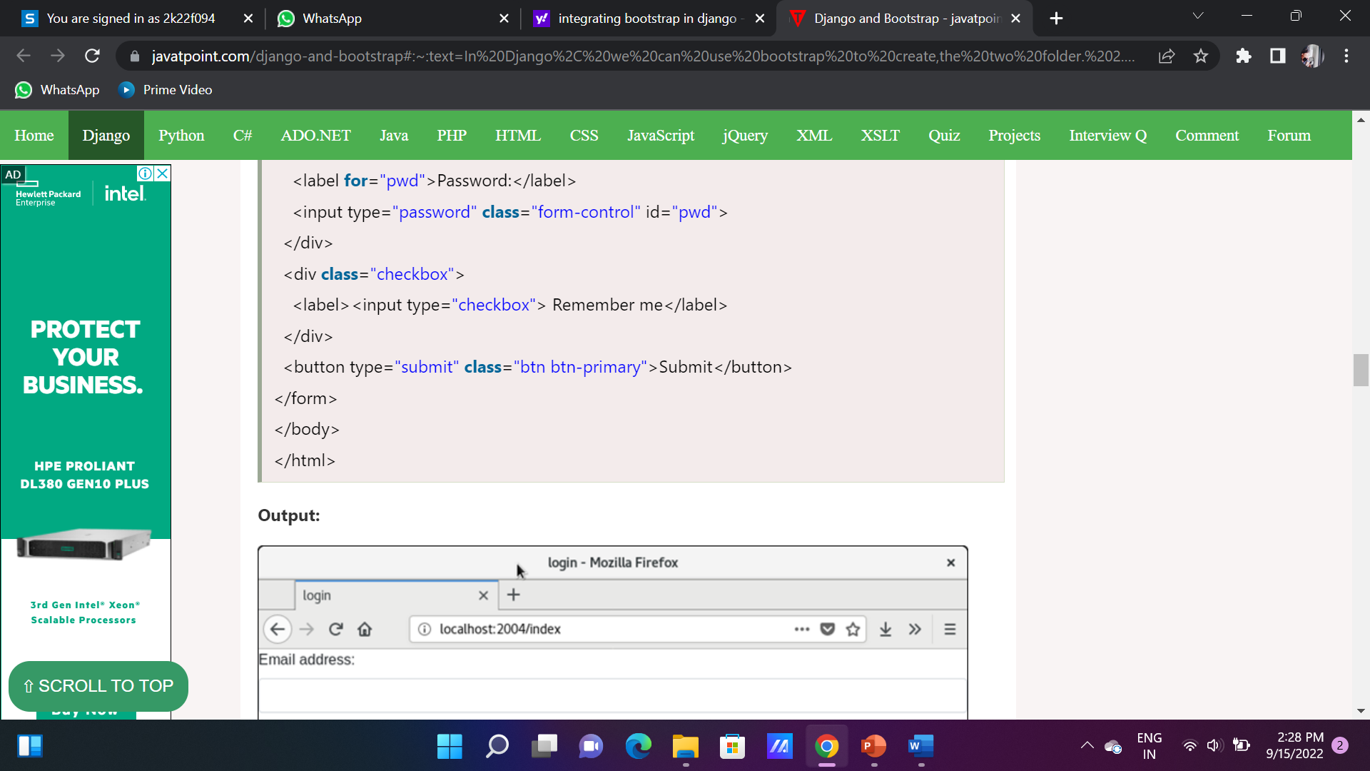
After loading bootstrap files. Our code look like this:
index.html

Slide 47
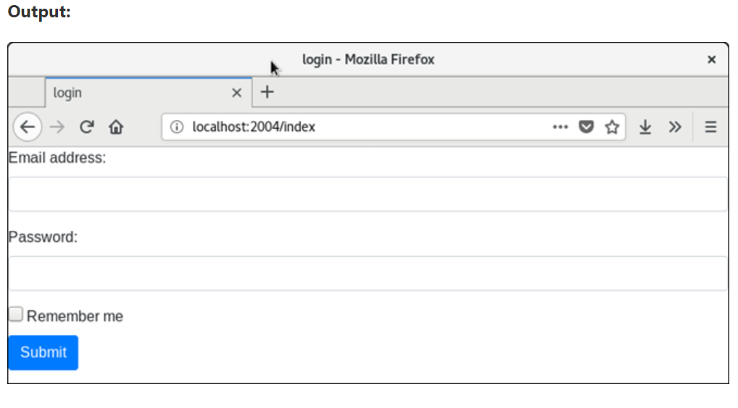

Slide 48
Creating Carousels with Bootstrap
The carousel also known as slideshow or image slider is some of the best way of showcasing the huge amount of contents within a small space on the web pages. It is a dynamic presentation of contents where text and images are made visible or accessible to the user by cycling through several items.
The following example will show you how to build a simple carousel or slideshow with previous/next controls and indicators using the Bootstrap carousel plugin.

Slide 49
<div id="myCarousel" class="carousel slide" data-ride="carousel"> <!-- Indicators --> <ol class="carousel-indicators"> <li data-target="#myCarousel" data-slide-to="0" class="active"></li> <li data-target="#myCarousel" data-slide-to="1"></li> <li data-target="#myCarousel" data-slide-to="2"></li> </ol> <!-- Wrapper for slides --> <div class="carousel-inner"> <div class="item active"> <img src="la.jpg" alt="Los Angeles"> </div> <div class="item"> <img src="chicago.jpg" alt="Chicago"> </div> <div class="item"> <img src="ny.jpg" alt="New York"> </div> </div> <!-- Left and right controls --> <a class="left carousel-control" href="#myCarousel" data-slide="prev"> <span class="glyphicon glyphicon-chevron-left"></span> <span class="sr-only">Previous</span> </a> <a class="right carousel-control" href="#myCarousel" data-slide="next"> <span class="glyphicon glyphicon-chevron-right"></span> <span class="sr-only">Next</span> </a> </div>

Slide 50
The outermost <div>:
Carousels require the use of an id (in this case id="myCarousel") for carousel controls to function properly.
The class="carousel" specifies that this <div> contains a carousel.
The .slide class adds a CSS transition and animation effect, which makes the items slide when showing a new item. Omit this class if you do not want this effect.
The data-ride="carousel" attribute tells Bootstrap to begin animating the carousel immediately when the page loads.
The "Indicators" part:
The indicators are the little dots at the bottom of each slide (which indicates how many slides there are in the carousel, and which slide the user is currently viewing).
The indicators are specified in an ordered list with class .carousel-indicators.
The data-target attribute points to the id of the carousel.
The data-slide-to attribute specifies which slide to go to, when clicking on the specific dot.

Slide 51
The "Wrapper for slides" part:
The slides are specified in a <div> with class .carousel-inner.
The content of each slide is defined in a <div> with class .item. This can be text or images.
The .active class needs to be added to one of the slides. Otherwise, the carousel will not be visible.
The "Left and right controls" part:
This code adds "left" and "right" buttons that allows the user to go back and forth between the slides manually.
The data-slide attribute accepts the keywords "prev" or "next", which alters the slide position relative to its current position.

Slide 52
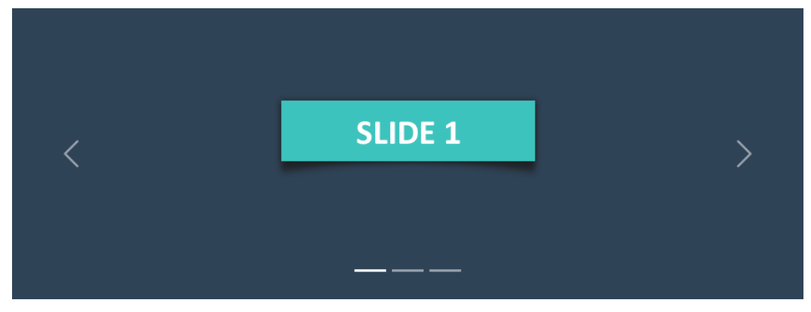
The output of the above example will look something like this:

